Slide 1





Project 1
US Hiring and Visa Applications
Copyright © Cognitior
www.cognitior.com

Slide 2
Dataset Information
The result of 2016 applications for H1B visas
NAICS codes
US States
Copyright © Cognitior
www.cognitior.com

Slide 3
Objective
The objective of the given project is to analyse the US Visa dataset along with the help of supporting databases to derive meaningful insights regarding the factors affecting acceptance of work visa
Copyright © Cognitior
www.cognitior.com

Slide 4
Important Inferences
to be made
1) What are the top 10 occupations for H1B visas with certified status?
2) Which company hires more data scientists?
3) What is the average salary for data scientists? How it is compared to the mean of applications?
4) Which state has the higher deny proportionally to application. And proportionally to the population?
5) What industries are in the top 5 percentile of applications?
6) Does the month of the application play any role in to denied process? What about decision dates?
Copyright © Cognitior
www.cognitior.com

Slide 5
Problem Approach
The expected inferences were based directly on the dataset provided and demanded only the extraction of necessary information from the given dataset(s) by slicing and merging tables.
Copyright © Cognitior
www.cognitior.com

Slide 6
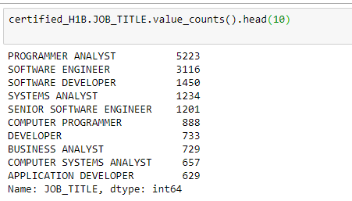
Important Inferences
Results
1) What are the top 10 occupations for H1B visas with certified status?
Ans) The given list summarizes the top 10 occupations (along with the count) for which the visas were certified.
Copyright © Cognitior
www.cognitior.com

Slide 7
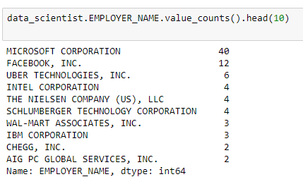
Important Inferences
Results
2) Which company hires more data scientists?
Ans) Microsoft Corporation recruited maximum Data Scientists.
Copyright © Cognitior
www.cognitior.com

Slide 8
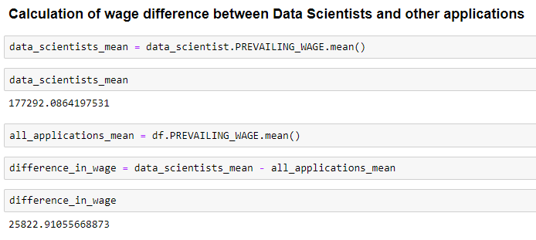
Important Inferences
Results
3) What is the average salary for data scientists? How it is compared to the mean of applications?
Ans) Average Salary for Data Scientist = $177,292/-
It is greater than about $25,823 as compared to all the applications.
Copyright © Cognitior
www.cognitior.com

Slide 9
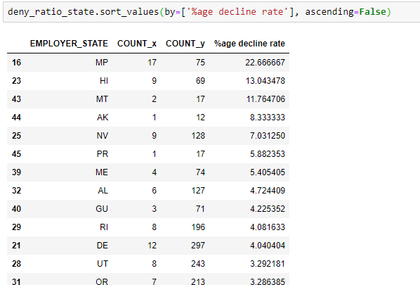
Important Inferences
Results
4) Which state has the higher deny proportionally to application. And proportionally to the population?
Ans) Highest Deny Proportional to applications = Mississippi
Copyright © Cognitior
www.cognitior.com

Slide 10
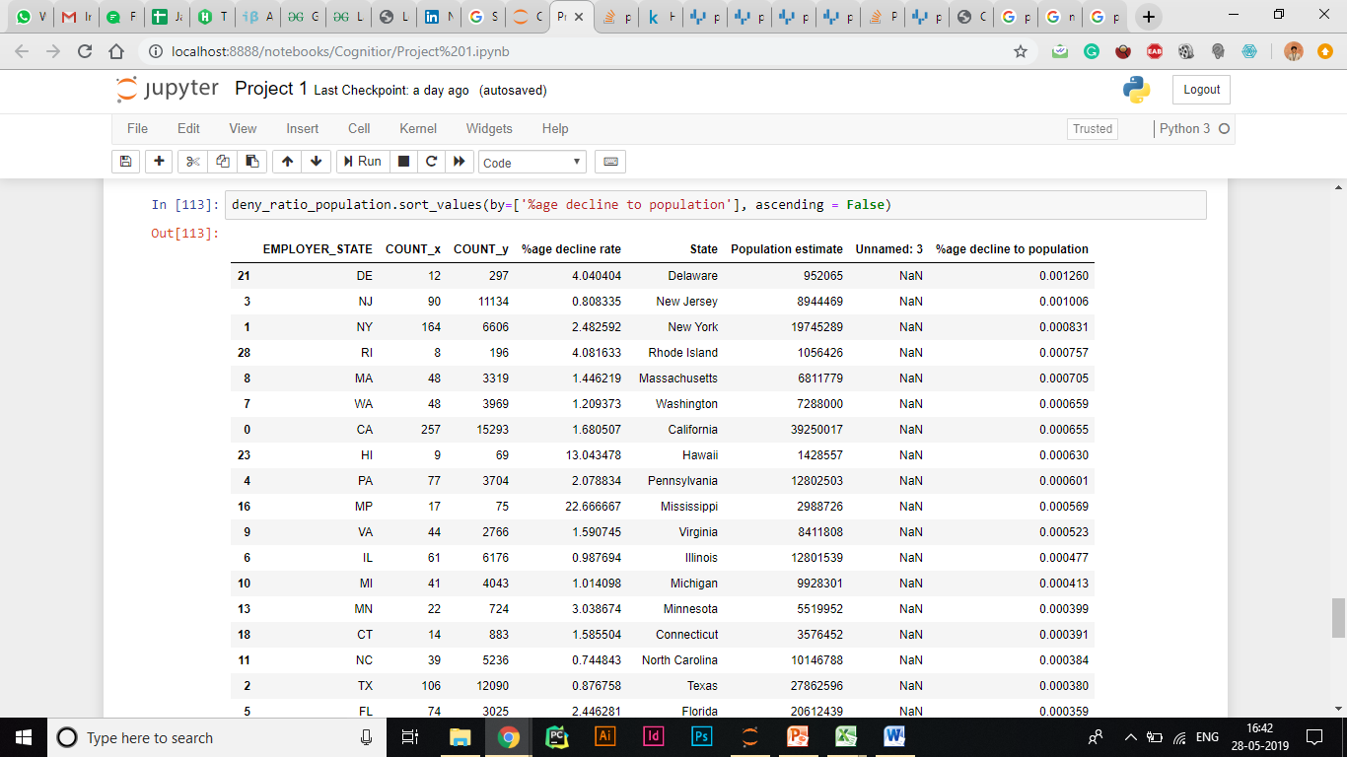
Important Inferences
Results
4) Which state has the higher deny proportionally to application. And proportionally to the population?
Ans) Highest Deny Proportional to population = Delaware
Copyright © Cognitior
www.cognitior.com

Slide 11
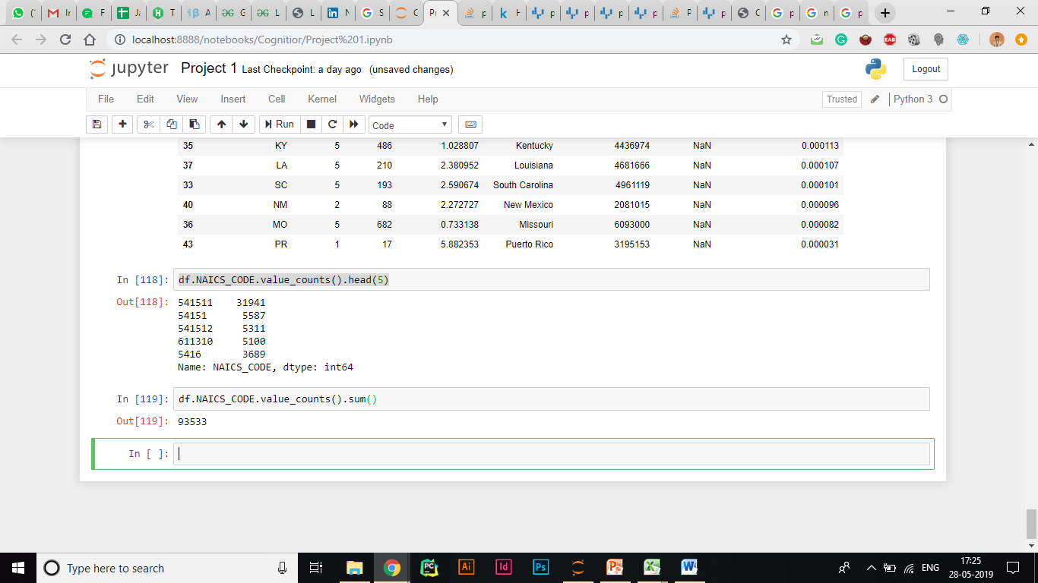
Important Inferences
Results
5) What industries are in the top 5 percentile of applications?
Ans) About 1/3 applications were for applying to Custom Computer Programming Services.
Copyright © Cognitior
www.cognitior.com

Slide 12
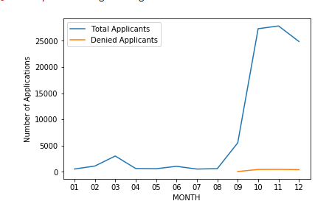
Important Inferences
Results
6) Does the month of the application play any role in to denied process? What about decision dates?
Ans) September to October saw an increase in the number of applications. Number of denied were almost constant in these months
Copyright © Cognitior
www.cognitior.com

Slide 13
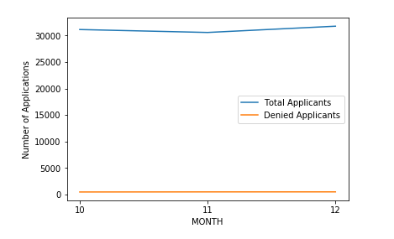
Important Inferences
Results
6) Does the month of the application play any role in to denied process? What about decision dates?
Ans) Decision dates did not seem to have any impact on the denied process
Copyright © Cognitior
www.cognitior.com

Slide 14
Thank You!!!
Any Questions?
support@cognitior.com
Copyright © Cognitior
www.cognitior.com

